Slide 1

Swan Consulting: Customer Churn Analysis
Customer Churn Analysis

Slide 2
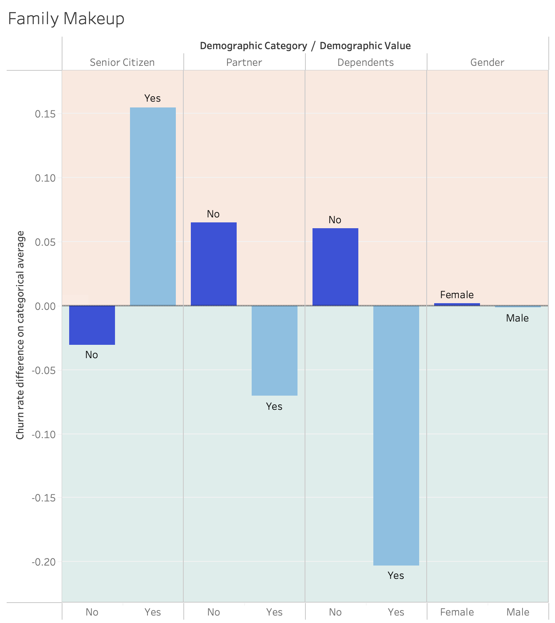
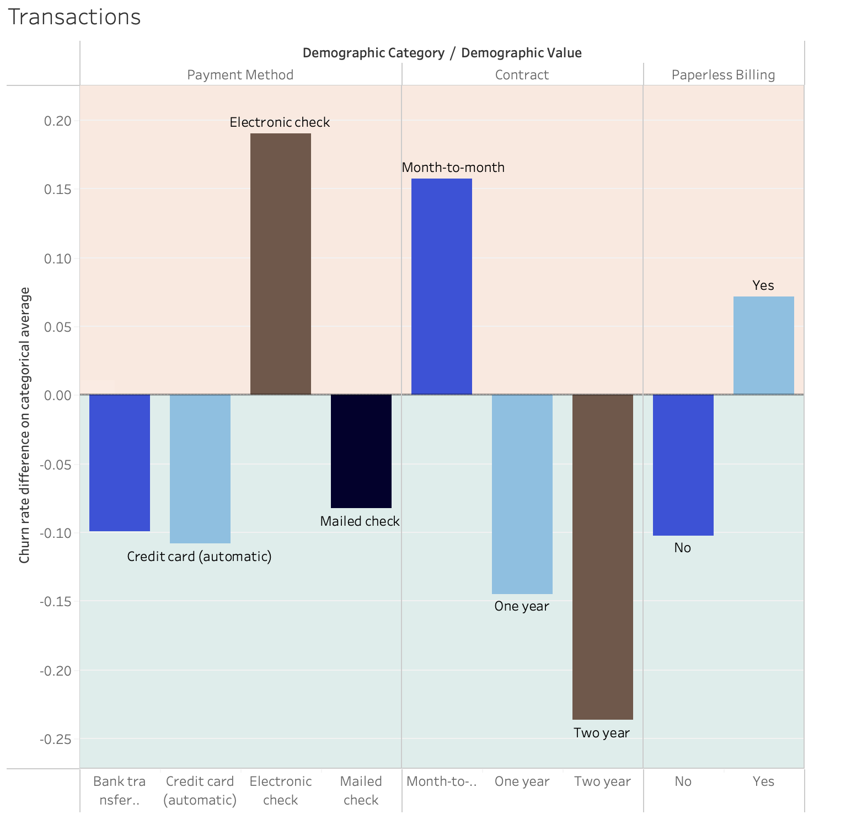
Contract type extremely important for churn
Senior Citizens significantly more likely to churn
Gender has no impact
Having a partner/dependents reduces churn risk, especially dependents
Electronic checks and paperless billing increase churn

Slide 3
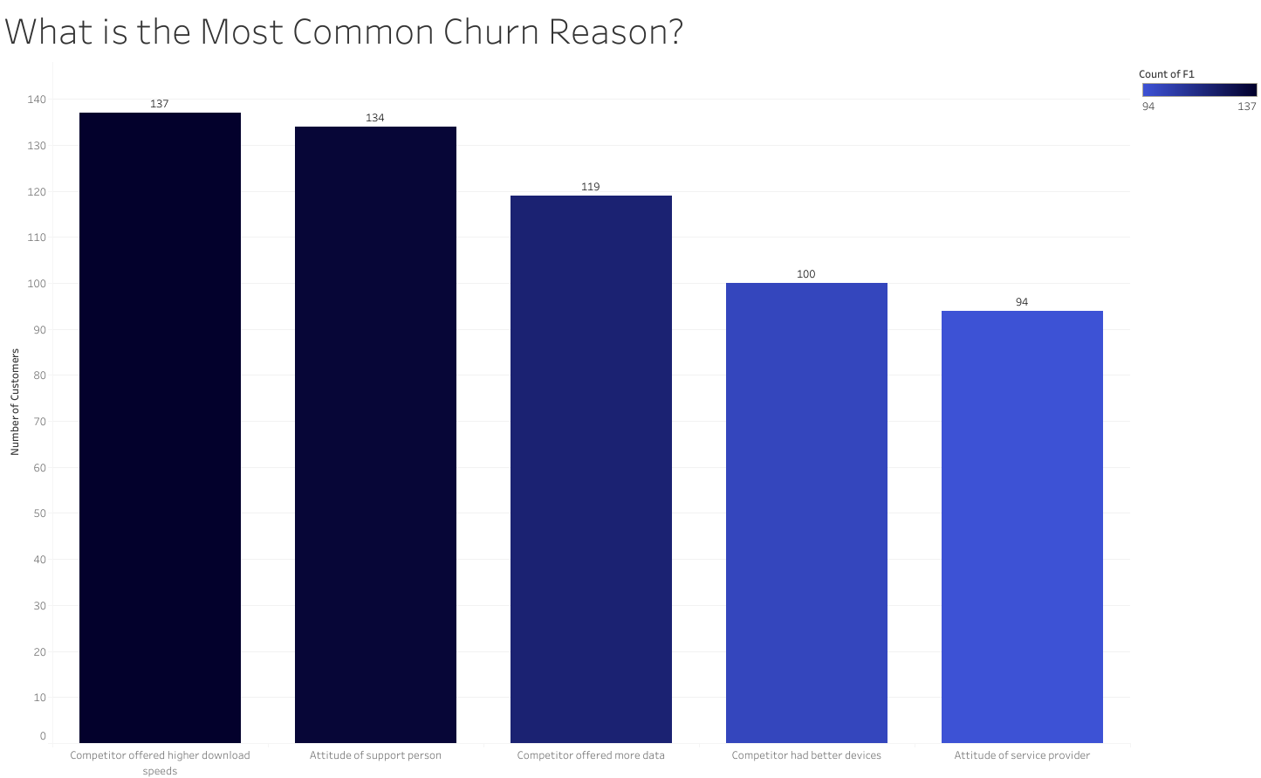
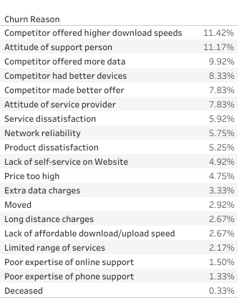
Attitude and Offers from Competitors are the most important reasons: 49% of all reasons
Note: we exclude don’t know submissions to gather insights

Slide 4
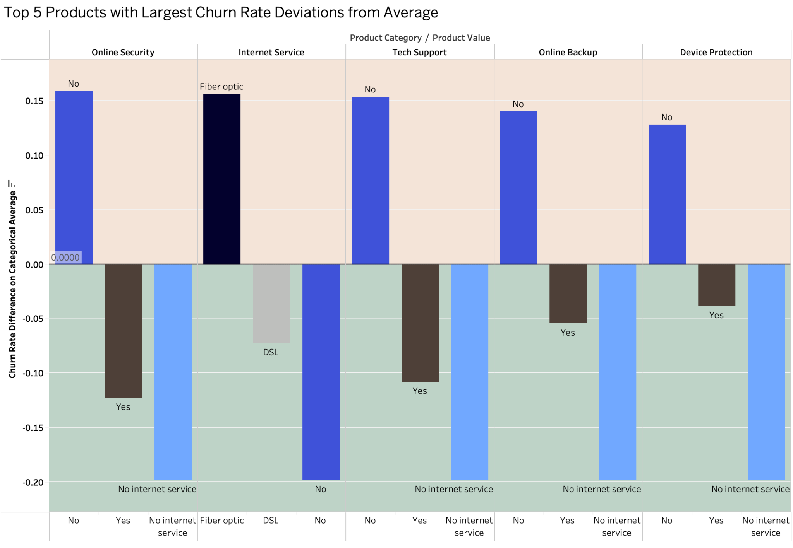
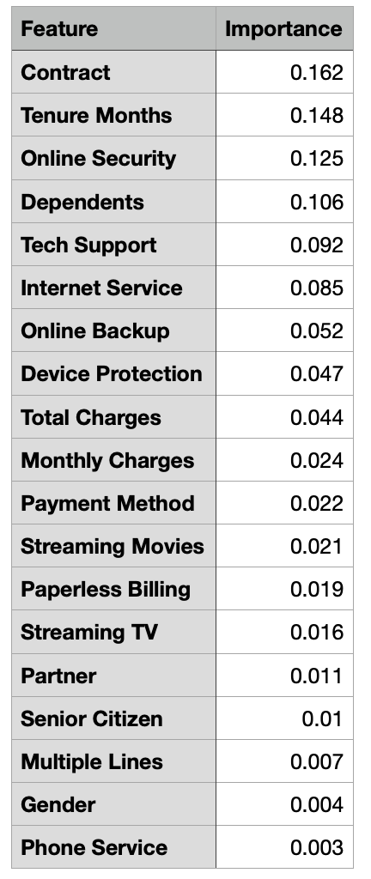
Online Security is the most important product for reducing churn risk: would benefit from targeted incentives

Slide 5
Summary:
Churner demographics: senior citizens; no partner or dependents; gender irrelevant
Contract type extremely important: two year contracts reduce churn
Attitude and competition most common reasons
Online Security is the best product to incentivise

